Slide 1

The Linux OS stack:
Introduction to shell, system calls & kernel

Slide 2
Linux Features
UNIX-like operating system.
Features:
  Preemptive multitasking.
  Virtual memory (protected memory, paging).
  Demand loading, dynamic kernel modules.
  SMP support.
  Open source.

Slide 3
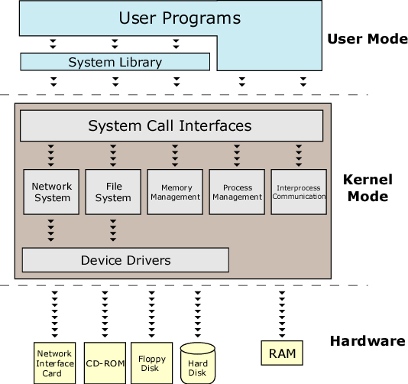

Slide 4
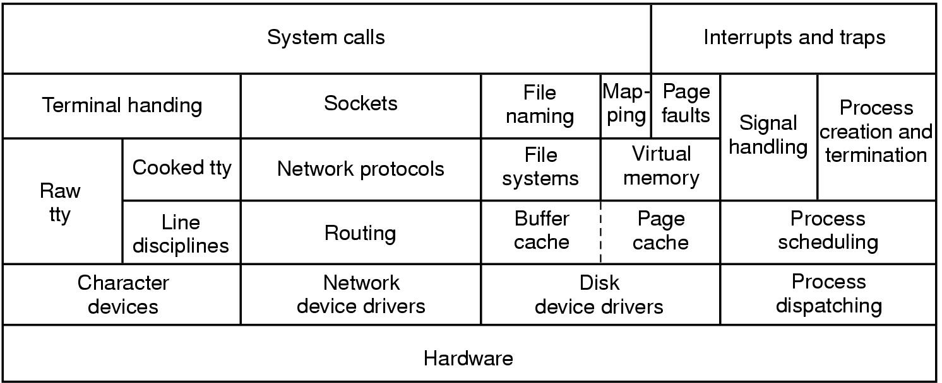
The Kernel
The kernel is responsible for maintaining the important abstractions of the operating system.
It provides the main functions of the abstract machine (system calls and Interrupt and traps).
Approximate structure of generic UNIX kernel

Slide 5
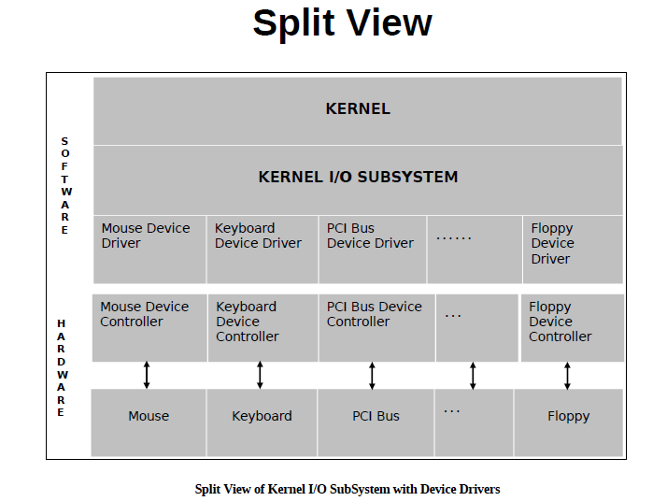

Slide 6
Linux Architecture
Applications
System Libraries (libc)
System Call Interface
I/O Related
Process Related
Modules
File Systems
Scheduler
Networking
Memory Management
Device Drivers
IPC
Architecture-Dependent Code
Hardware
Notes:
Stephen Tweedie claims “All kernel code executes in a process context (except during startup)”. He also says that it is possible for an interrupt to occur during a context switch.
So it is uncommon for there to be no user process mapped. The real problem is not knowing what process is mapped. Kernel mode, system context activities occurs asynchronously and may be entirely unrelated to the current process.

Slide 7
Summary
Linux is a modular, UNIX-like kernel.
Kernel is the heart of the OS that executes with special hardware permission (kernel mode).
Kernel provides framework, data structures, support for drivers, modules, subsystems.
Architecture dependent source sub-trees live in /arch.
Notes:
BOOKS
Maxwell Chapter 4: System Initialization
Rubini Chapter 16 pages 362-369
Beck 3.2.3
GUIDES
Linux System Administrator’s Guide
HOWTOs
Bootdisk-HOWTO
BootPrompt-HOWTO
Diskless-HOWTO
Diskless-root-NFS-HOWTO
KERNEL DOC
Documentation/initrd.txt
Documentation/ramdisk.txt
APPLICATION DOC
LILO: User’s Guide
LILO: Technical Overview
OTHER
UltraLinux FAQ: Section 6 Booting
Intel Architecture Software Developer’s Manual Volume 3: System Programming
SA-110 Microprocessor Technical Reference Manual
GNU GRUB
Multiboot Standard
OpenPROM
Solaris “man boot”

Slide 8
System Calls
Interface between user-level processes and hardware devices.
  CPU, memory, disks etc.
Make programming easier:
  Let kernel take care of hardware-specific issues.
Increase system security:
  Let kernel check requested service via syscall.
Provide portability:
  Maintain interface but change functional implementation.

Slide 9
System calls
System calls (or syscalls) are function calls made from user space programs into the kernel requesting for some service
Examples:
Open( ),read( ), write( ), fork( ), lseek( ), clone( ), wait ( ), etc..

Slide 10
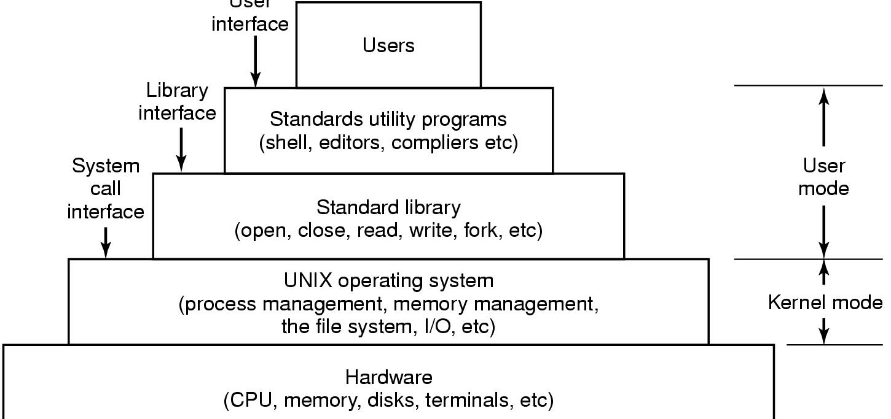
The layers of a LINUX system
User
Interface

Slide 11
Application using Standard Library Interface
#include <stdio.h>
int main()
{
printf(“Hello World\n”);
return(0);
}

Slide 12
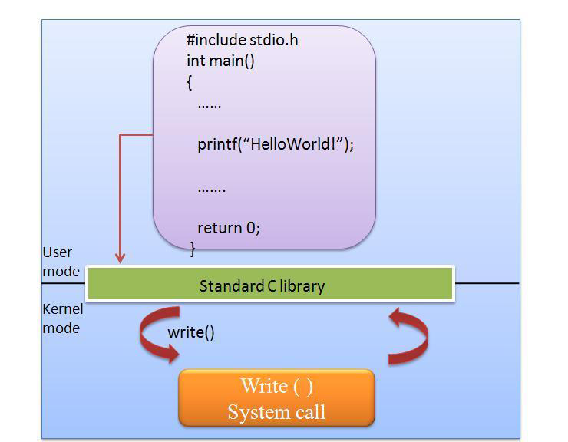
Standard library Vs system call

Slide 13
Application using System Call Interface
include <unistd.h>
int main()
{
write(1,”Hello World\n”, 12);
return(0);
}

Slide 14
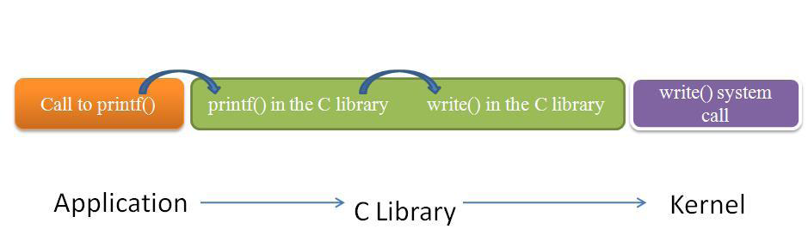
Application ->C Library ->KernelCentre

Slide 15
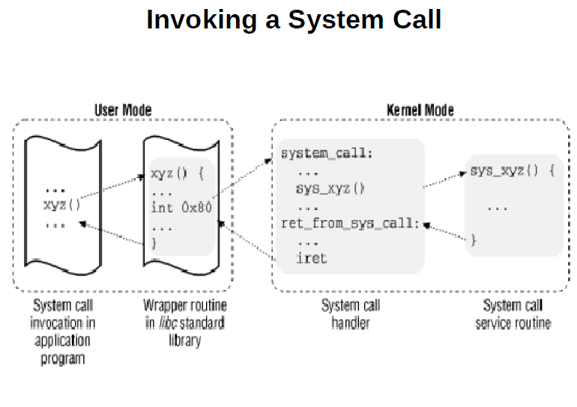

Slide 16
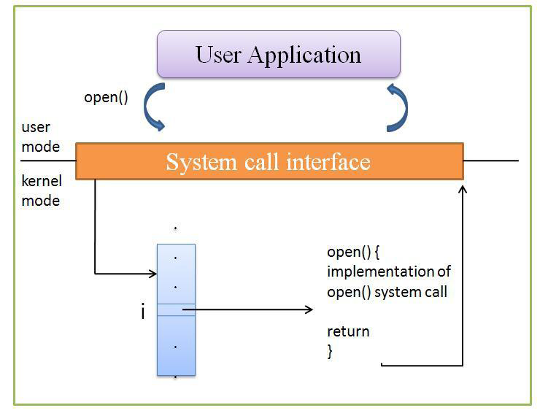
Access to kernel services

Slide 17
System Call Handling
User-space applications cannot execute kernel code directly
The mechanism to signal the kernel is a software interrupt
Occurs through an exception and then the system will switch to kernel mode and execute the exception handler

Slide 18
System call Handling
Each system call is assigned a syscall number.
The kernel keeps a list of all registered system calls in the system call table, stored in sys_call_table.
On x86, the syscall number is fed to the kernel via the eax register.

Slide 19
Linux System Calls
Invoked by executing int $0x80.
  Programmed exception vector number 128.
  CPU switches to kernel mode & executes a kernel function.
Calling process passes syscall number identifying system call in eax register (on Intel processors).
Syscall handler responsible for:
  Saving registers on kernel mode stack.
  Invoking syscall service routine.
  Exiting by calling ret_from_sys_call().

Slide 20
Parameter Passing
On the 32-bit Intel 80x86:
  6 registers are used to store syscall parameters.
    eax (syscall number).
    ebx, ecx, edx, esi, edi store parameters to syscall service routine, identified by syscall number.

Slide 21
Parameter passing
In case of six or more arguments, a single register is used to hold a pointer to user-space where all the parameters are stored
The return value is sent to user-space also via register. On x86, it is written into the eax register

Slide 22
Linux Kernel Files Relating to System calls
Main files:
  arch/i386/kernel/entry.S
    System call and low-level fault handling routines.
  include/asm-i386/unistd.h
    System call numbers and macros.
  kernel/sys.c
    System call service routines.

Slide 23
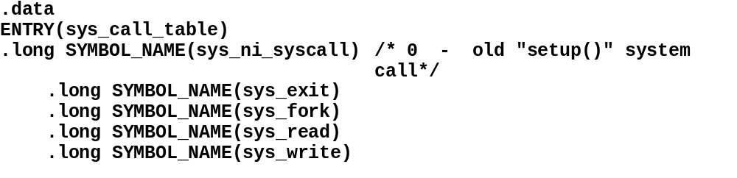
arch/i386/kernel/entry.S
  Add system calls by appending entry to sys_call_table:
  .long SYMBOL_NAME(sys_my_system_call)

Slide 24
include/asm-i386/unistd.h
Each system call needs a number in the system call table:
  e.g., #define __NR_write 4
  #define __NR_my_system_call nnn, where nnn is next free entry in system call table.

Slide 25
kernel/sys.c
Service routine bodies are defined here:
e.g., asmlinkage retval
  sys_my_system_call (parameters) {
  body of service routine;
  return retval;
  }

Slide 26
Fetch execute algorithm
PC = <machine start address>;
IR = memory[PC];
haltFlag = CLEAR;
while(haltFlag not SET)
{
execute(IR);
PC = PC + sizeof(INSTRUCT);
IR = memory[PC]; // fetch phase
}

Slide 27
Shell
Shell is a command interpreter( a special program) which act as a user interface to kernel
In other words it acts as an interface between the user and the kernel.
It provides a Command line interface (CLI)
It interpret the command s user types in and arranges for them to be carried out. Commands are themselves programs!
So user can interact with the hardware through shell and kernel.

Slide 28
User View of Linux Operating System
Applications
Shell
Kernel
Hardware

Slide 29
Different shells
Sh
Bsh
Csh
Tcsh
Ksh
Busybox : used with linux for embedded application

Slide 30
Shell commands
Cal, date, echo, passwd, who, who am I
Pwd, mkdir, cd, rmdir, rm, ls
Cat, cp, rm, mv, more, lp, file, wc, less
Cmp, diff, gzip, tar
Chmod, chown, tee
Ps, nice, at, cron, time,
ln, umask, su,echo
head, tail, tr, cut, sort
find, grep, sed, umask

Slide 31
Shell commands
Kill, fdisk, mkfs
Bc, uname, touch, ls, ln
Editors : vi, ed, gedit, emacs, pico
Ping, telnet, ftp, ssh
Nice, at, du, df, nohup

Slide 32
Shell programming constructs
If
Test
Case
Expr
While
For

Slide 33
Utlities
ftp
telnet
Ssh
Ping
ifconfig
Gcc
Ld
make

Slide 34
Input output redirection
ls > temp
Cat temp
ls >>temp

Slide 35
Who > temp
sort < temp
Wc –l < temp
Count the files in a directory ?

Slide 36
pipes
Is a way to connect the output of one program to the input of other program without any temporary file
Ls | wc –l
Who|grep mary | wc –l

Slide 37
files
File is a container for storing information.
All file attributes are stored in in separate area of harddisk called ‘i node table’
Unix treats directories and devices as files as well
All physical devices like harddisk, memroy, printer etc are treated as files. Shell is also a file
3 categories of files are
  Ordinary file (text or binary)
  Directory file
  Device file (char or block)

Slide 38
File permission
Every file has a set of permissions asociated with it, which determine who can do what with the file
Super user (root) is a special user who can read or modify any file on the system.
  eg: su
  cat /etc/passwd : which contains all the login information about each user
Three kinds of permissions for each file is
  Read, write, execute

Slide 39
Three domain entities are
  Owner, group, others
Ls –l prints the full permission
drwxrwxrwx
/etc/passwd, /bin/passwd
Chmod – change mode
  Chmode permission filename
  Chmod +x tmp.txt

Slide 40
Meta data
For example, if I own a car then I have a set of information about the car but which is not part of the car itself. Information such as the registration number, make, model, year of manufacture, insurance information, and so on. All of that information is collectively referred to as the metadata. In Linux and UNIX file systems metadata exists at multiple levels of organization as you will see.
In simple words Metadata describes the structure of the file system. Most common metadata structure are superblock, inode, directory and file

Slide 41
Super block
The superblock is essentially file system metadata and defines the file system type, size, status, and information about other metadata structures . The superblock is very critical to the file system and therefore is stored in multiple redundant copies for each file system.

Slide 42
i node block
An inode (short for "index node") is a bunch of attributes about a file that Linux stores. There is one inode for each file (though with some filesystems, Linux has to create its own inodes because the information is spread around the filesystem). The inode stores information like who owns the file, how big the file is, and who is allowed to open the file. Each inode also contains a number unique to the filesystem partition; it's like a serial number for the file described by that inode.

Slide 43
Inode attributes
  Name
  Permission details
  I node number
  Disk location
  3 time level info
    When last modified
    When last used
    When inode itself was last changed
  Ls - i : reports the i node number of a file

Slide 44
Files & Dentries
Dentry
A dentry (short for "directory entry") is what the Linux kernel uses to keep track of the hierarchy of files in directories. Each dentry maps an inode number to a file name and a parent directory.
A file just means a bunch of bytes arranged in a certain order. It's what normal people call the contents of a file. When Linux opens a file, it also creates a file object, which holds data about where the file is stored and what processes are using it. The file object (but not the file data itself) is thrown away when the file is closed.

Slide 45
process
A program in execution
Process make things happen in Linux
It is an instance of running program.
A process is said to be born when the program starts its execution and remain alive as long as the program is active
Kernel is responsible for the management of process
Process also have attributes
Attributes of process are maintained by the kernel in the memory called process table (PCB). Important attributes are
  Process id
  Parent id etc

Slide 46
Process can be created by system calls like fork(), execv()
Kill system calls to kill the proces
Ps commands to list the process status
Ps –ef | grep jay
Kill pid

Slide 47
devices
Unix treats all peripherals as a file
eg: tape - /dev/mt0
hdd - /dev/hda1
flopy - /dev/floppy
cd - /mnt/cd
-df, du system calls

Slide 48
filters
cut, sort
Find
  Allows us to search files
  Locating files
  Find path selectioncriteria action
  Eg : find . –name a.out –print
  How to locate all directories ?
    Find . - type d -rpint

Slide 49
Find examples
Files which are modified with in 2 days
  Find . mtime -2 -print
All files that have not been accessed for more than a year
  Find /home –type f –atime +365 –print
List all non .c files
  Find . ! –name “*.c” –print
Delete all files those who are not used for the past 30 days
  Find . –atime +30 –exec rm{ } \;

Slide 50
Selection criteria
  Mtime –x : if modified in less than x days
  Atime +x : if accessed in less than x days
  - name fname : file name
Action
  Print
  Ls
  Exec cmd : execute command followed by { } \;

Slide 51
Regular expression – patternmatcthing
Shell’s wild card charactors: which are used to construct the generalized pattern for matching file names belong to a catogery called wild-cards
  * - any number of chars
  ? – a single char
  [ijk] – single char i/j/k
  g* - g/gg/ggg etc
  ^pat – search for pattern pat at beginning of astring
  pat$ - pattern pat at end
  ^bash$ - bash as the only word
  ^$ - line containing nothing
If an expression uses any of these charactors, it is termed as regular expression.

Slide 52
Filter - Grep
Global regular expression pattern matcher
  Grep –c “director” emp.lst
  Grep –l manager *.lst
  Grep options pattern files
  Check if a particular user is logged on by combining who & grep
  Who | grep mary
  How many times the user jay is logged?
  who | grep jay | wc -l

Slide 53
List of sub directory names
  Ls –l | grep ‘^d’
Count no of no of sub directories in the present directory
  Ls –l | grep ‘^d’ | wc –l
Grep scans its input for a pattern and displays lines conatining the pattern, the line number or filenames where the pattern occur

Slide 54
Stream editor - sed
Is a multipurpose tool which combines the work of several filters
Eg : sed command filename
sed ‘s/UNIX/UNIX™ /g’ unixbasics.txt

Slide 55
Awk pattern matcher
Is an improved form of sed. Some of the limitation of sed are remedied by awk

Slide 56
Shell script
When a group of commands have to be executed regularly, they should be stored in a file, and the file itself executed as a shell script or shell program
Shell scripts are executed in a separate child process
Sample script
    #! /bin/bash
    # script.sh sample script
    Echo “my shell: $SHELL”

Slide 57
To run the script, make it executable first and then invoke the script name
chmod + x script.sh
./script.sh

Slide 58
Read : making script interactive
Read variable name
Program

Slide 59
Shell variables
Shell has variables like those in most programming languages.
Eg : PATH is a list of directories to search for
HOME : your login directory
Values of variable is extracted by preceeding the name by ‘$’
    Echo $PATH
    dir= `pwd`
    Cd $dir
Variable = value

Slide 60
Environmental varibale
Shell variables are of 2 typs
  Local
  environmental
PATH, HOME, SHELL etc are env varibales
They are so called because they are variables in the user’s total environment
Local variables are more restricted in scope
Its values will not be available to child process
bash; echo $dir
Set variable displays all variables available in the current shell
Env displays only env variables

Slide 61
A local variable can be converted to an environmental variable using the shell’s EXPORT statement
Environmental variable controls the behavior of the system. They determine the environment in which you work

Slide 62
.profile file
The initialization script
We have assigned values to many of the env variables, these settings are only applicable for the current session. They revert to their old values when the user logs out.
To make these settings permanent you will have to place them in certain startup script
Every shell uses at least one startup script in the user’s home directory. This script is executed when the user logs in.
This login script should be added to your home directory at the time of user creation.

Slide 63
Shell constructs : case condition
Case expression in
  Pattern1) commands1;;
  Pattern2) commands2;;
  .
  .
  Esac
  Example program

Slide 64
computation
X=3, y=5
  Expr 3+5
  Expr $x - $y
  Z =`expr $x +$y`
  Echo $z
  X=5
  X =`expr $x + 1`
  Echo $x

Slide 65
While looping
While condition is true
  Do
  commands
  Done
  example

Slide 66
Until command
Until (condition)
  Do
  loop body
  Done
  Until who | grep jay
  do
  sleep 60
  done

Slide 67
For looping
For variable in list
do
commands
done

Slide 68
palimdrome
#! /bin/bash
clear
echo enter a string
read string
reverse = $(echo $string | rev)
if [$string = $reverse]
then
echo “ given string is palimdrome”
else
echo” not palimdrome
fi

Slide 69
If construct
If command
  Then
  commands
  Else
  commands
  fi

Slide 70
Test : to evaluate expressi
x=5; y=7
Test $x –lt $y ; echo S?

Slide 71
Command line argument
You can pass command line arguments to bash shell script. These are helpful to make a script more dynamic.

Slide 72
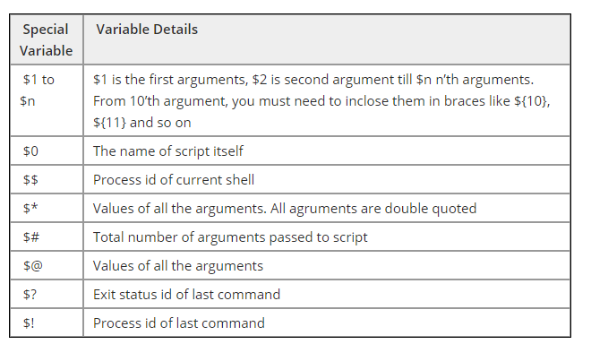
Command line argument

Slide 73
Sample program
2 3 4 5 6 7 8 9 10 11 12 13 14 15 16 17 | #!/bin/bash echo "Total Arguments:" $# echo "All Arguments values:" $@ echo "First->" $1 echo "Second->" $2 args=("$@") echo "First->" ${args[0]} echo "Second->" ${args[1]}

Slide 74
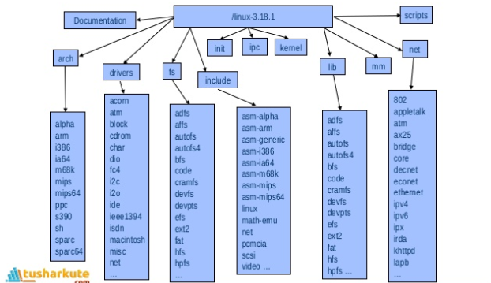

Slide 75
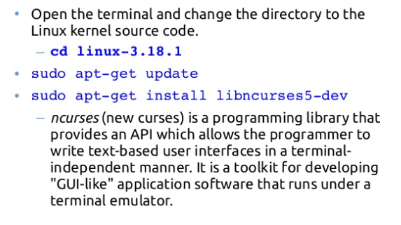

Slide 76
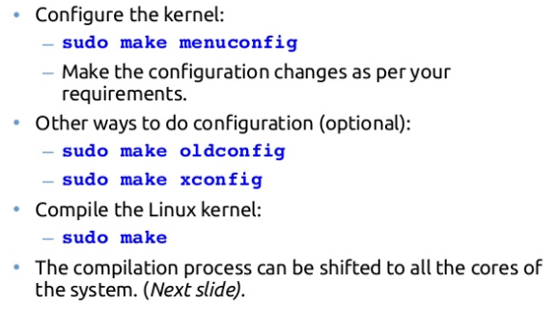

Slide 77
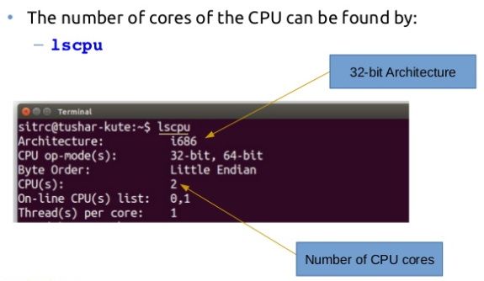

Slide 78
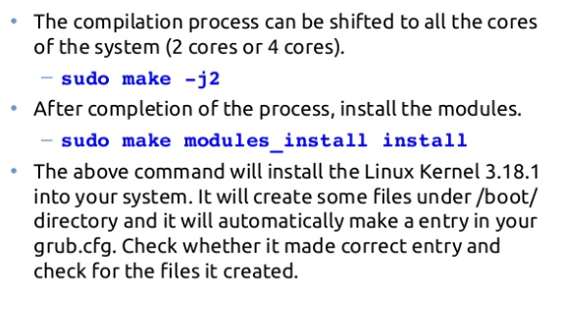

Slide 79
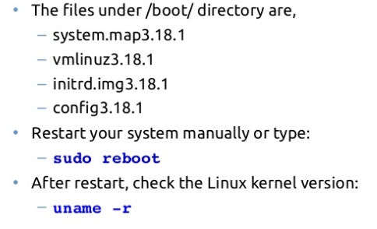

Slide 80
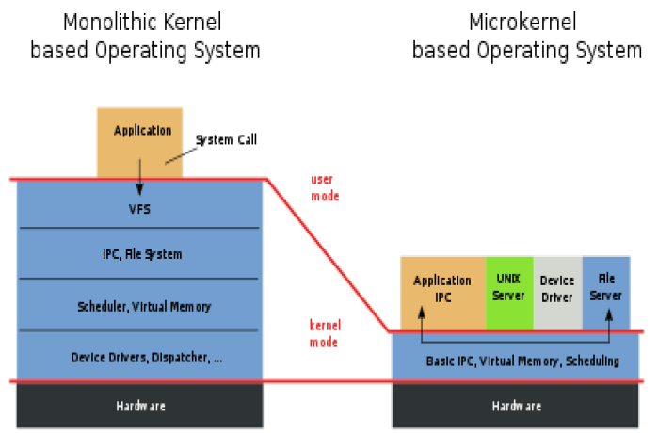
Monolithic Vs micro kernel

